Slide 1
Hello World!

Slide 2
Azure for Trainers
Donnertag, 15. Juli 2021
News
AZ-040
VS Code: Terminals
Transfer an Azure subscription to a different Azure AD directory
GitHub
Blog

Slide 3


Slide 4

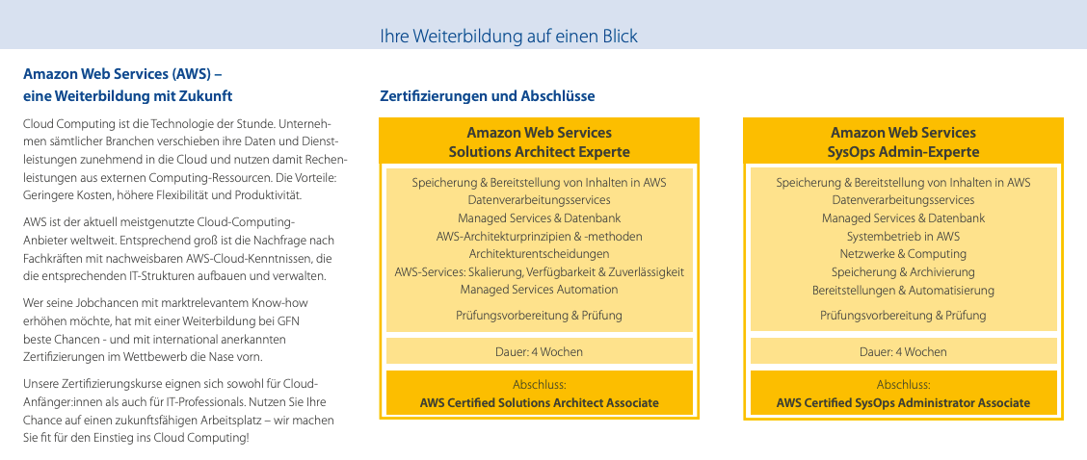
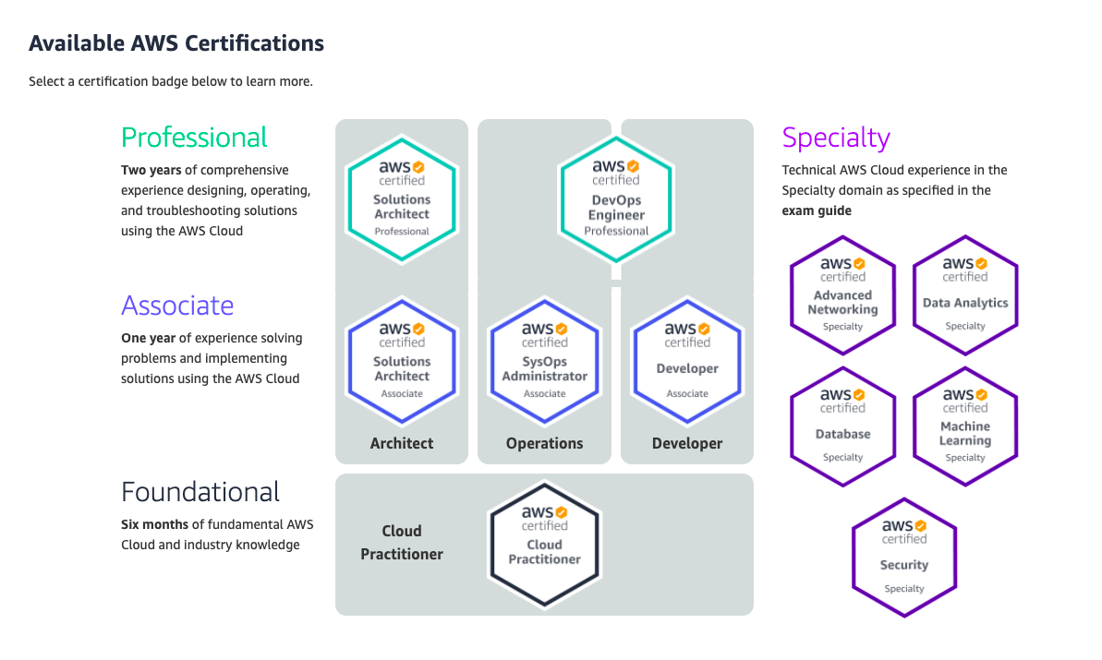

Slide 5
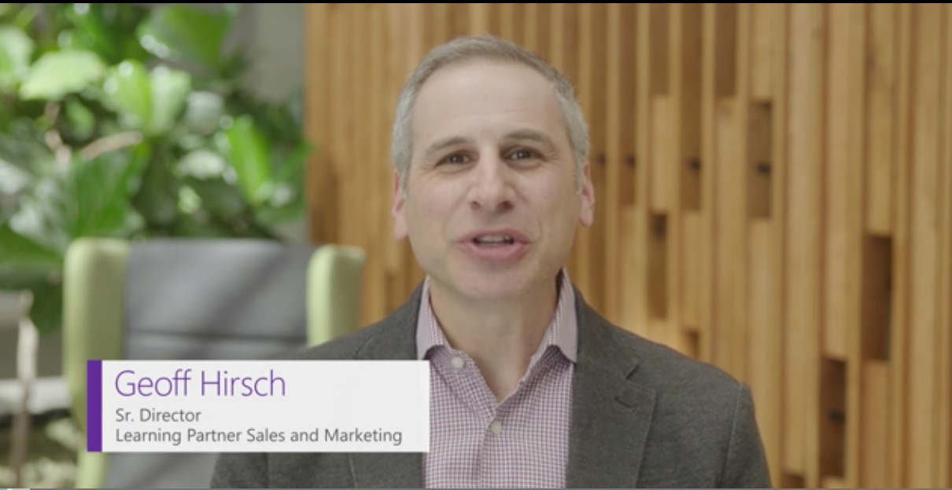
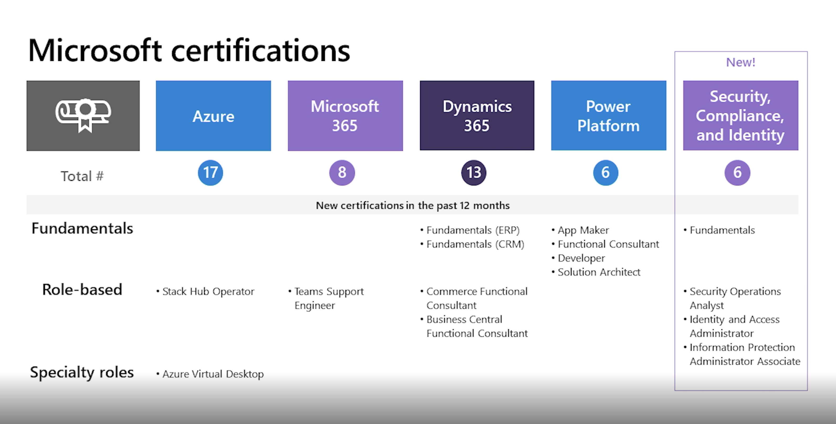
Microsoft Inspire - Learning Partner Strategy FY 22

Slide 6
Free MCT + MOC

Slide 7
X + AZ-500 = 5
AZ-500 + Y = 5
X = SC-900 :-(
Y = Automating Azure Security Stuff with PowerShell
Y = Azure Sentinel Configuration

Slide 8
AZ-040
Automating Administration with Windows PowerShell
Replacing legacy course 10961 (Retirement date Dec 2021)
Actual release date: Q1 FY 22 (Sept 2021)
5 Days
Course description Certification/Exam? GitHub repo Labs HTML Download Center
 | AZ-040 | 10961
Module 1 | Getting started with Windows PowerShell | Getting started with Windows PowerShell (Mod 1)
Module 2 | Windows PowerShell for local systems administration | Cmdlets for administration (Mod 2)
Module 3 | Working with the Windows PowerShell pipeline | Working with the Windows PowerShell pipeline (Mod 3) Understanding how the pipeline works (Mod 4)
Module 4 | Using PSProviders and PSDrives | Using PSProviders and PSDrives (Mod 5)
Module 5 | Querying management information by using CIM and WMI | Querying system information by using WMI and CIM (Mod 6)
Module 6 | Working with variables, arrays, and hash tables | Working with variables, arrays, and hash tables. (Mod 7)
Module 7 | Windows PowerShell scripting | Basic scripting (Mod 8) Advanced scripting (Mod 9)
Module 8 | Administering remote computers with Windows PowerShell | Administering Remote Computers (Mod 10)
Module 9 | Managing Azure resources with PowerShell
Module 10 | Managing Microsoft 365 services with PowerShell
Module 11 | Using background jobs and scheduled jobs | Using background jobs and scheduled jobs (Mod 11)
 |  | Using advanced Windows PowerShell techniques (Mod 12)

Slide 9
VS Code: Terminals
Terminal vs. shell
Multiple terminals: Tabs vs. dropdown
Rename, change icon
Create or move terminals into the editor area
Terminal profiles
VS Code docs

Slide 10
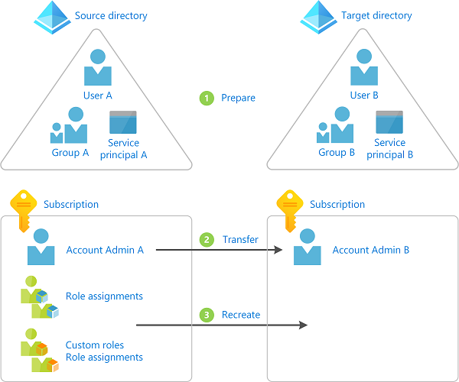
Transfer an Azure subscription to a different Azure AD directory
Microsoft docs

